Slide 1
PHP

Slide 2
Overview

Slide 3
What do you need?
1. Installing or configuring Wampserver / Xampp
2. Installing or configuring MySQL. (May be optional)
3. Installing or configuring Apache. (May be optional)
4. Installing or configuring PHP. (May be optional)

Slide 4
PHP’s in WWW
PHP: Hypertext Preprocessor
PHP is a programming language that’s used mostly for building websites.
Instead of a PHP program running on a desktop computer for the use of one person, it typically runs on a web server and is accessed by lots of people using web browsers on their own computers.
Web request - a conversation happen over the Internet between your computer and another computer.

Slide 5
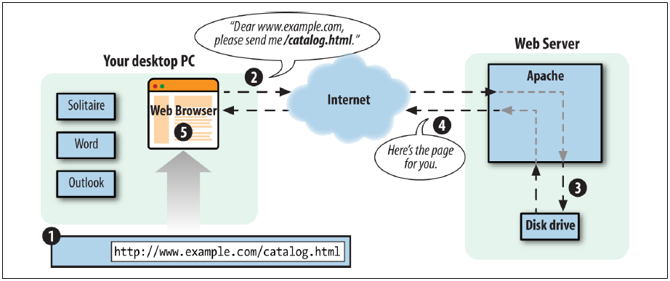
Client and Server Communication without PHP
Notes:
You type www.example.com/catalog.html into your browser’s location bar.
2. The browser sends a message over the Internet to the computer named
www.example.com asking for the /catalog.html page.
3. Apache HTTP Server, a program running on the www.example.com computer,
gets the message and reads the catalog.html file from its disk drive.
Apache sends the contents of the file back to your computer over the Internet as a
response to the browser’s request.
5. Your browser displays the page on your screen, following the instructions of the
HTML tags in the page.

Slide 6
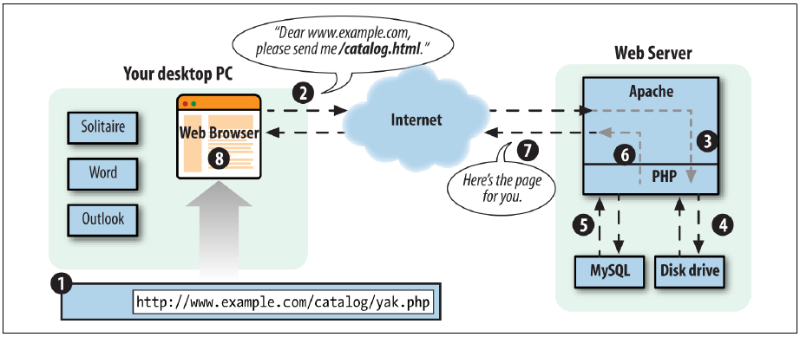
Client and Server Communication with PHP
Notes:
You type www.example.com/catalog/yak.php into your browser’s location bar.
2. Your browser sends a message over the Internet to the computer named
www.example.com asking for the /catalog/yak.php page.
3. Apache HTTP Server, a program running on the www.example.com computer,
gets the message and asks the PHP engine, another program running on the
www.example.com computer, “What does /catalog/yak.php look like?”
4. The PHP engine reads the file yak.php from the disk drive.
5. The PHP engine runs the commands in yak.php, possibly exchanging data with a
database program such as MySQL.
6. The PHP engine takes the yak.php program output and sends it back to Apache
HTTP Server as an answer to “What does /catalog/yak.php look like?”
7. Apache HTTP Server sends the page contents it got from the PHP engine back to
your computer over the Internet in response to your browser’s request.
8. Your browser displays the page on your screen, following the instructions of the
HTML tags in the page.

Slide 7
PHP – Server Side Scripting
PHP is called a server-side language because, it runs on a web server.
A language such as JavaScript can be used as a client-side language because, embedded in a web browser, it can cause that browser, while running on your desktop PC, to do something such as pop up a new window.
Once the web server has sent the generated web page to the client, PHP is out of the picture.
If the page content contains some JavaScript, then that JavaScript runs on the client, but it is totally disconnected from the PHP program that generated the page.

Slide 8
Advantages
PHP Is Free: there are no licensing fees, support fees, maintenance fees, upgrade fees, or any other kind of charge.
PHP Is Cross-Platform: runs Windows, Mac OS X, Linux, and many other versions of Unix.
PHP Is Widely Used: more than 200 million different websites, from countless tiny personal home pages to giants like Facebook, Wikipedia, Tumblr, Slack, and Yahoo
PHP Hides Its Complexity: build powerful ecommerce engines or small sites.
PHP Is Built for Web Programming: PHP was created from the ground up for generating web pages.

Slide 9
PHP Syntax

Slide 10
Basic Syntax
A PHP script is executed on the server, and the plain HTML result is sent back to the browser.
A PHP script can be placed anywhere in the document.
Syntax:
<?php
// PHP code goes here
?>
The default file extension for PHP files is ".php".
A PHP file normally contains HTML tags, and some PHP scripting code

Slide 11
Example 1: Print message
<!DOCTYPE html>
<html> <head><title>PHP says hello</title></head>
<body>
<h1>My PHP page</h1>
<?php
echo "Hello World!";
?>
</body>
</html>

Slide 12
Comments
A comment in PHP code is a line that is not read/executed as part of the program.
Its only purpose is to be read by someone who is looking at the code.
Comments can be used to:
Let others understand what you are doing
Remind yourself of what you did previously.

Slide 13
Comments
Multiway to declare comment
// This is a single-line comment
# This is also a single-line comment
/*
This is a multiple-lines comment block
that spans over multiple
lines
*/
// You can also use comments to leave out parts of a code line

Slide 14
Example 2: Comment in Codes
<!DOCTYPE html> <html> <body> <?php
$x = 5 /* + 15 */ + 5;
echo $x;
?>
</body>
</html>

Slide 15
PHP Case Sensitivity
In PHP, all keywords (e.g. if, else, while, echo, etc.), classes, functions, and user-defined functions are NOT case-sensitive.
<?php
ECHO "Hello World!<br>";
echo "Hello World!<br>";
EcHo "Hello World!<br>";
?>
BUT, all variable names are case-sensitive.

Slide 16
Example 3: Case Sensitivity
<?php
$color = "red";
echo "My car is " . $color . "<br>";
echo "My house is " . $COLOR . "<br>";
echo "My boat is " . $coLOR . "<br>";
?>

Slide 17
Variables
To store information / data.
A variable starts with the $ sign, followed by the name of the variable.
When you assign a text value to a variable, put quotes [“ “] around the value.
A variable can have a short name (like x and y) or a more descriptive name (age, carname, total_volume)

Slide 18
Variables
Rules :
A variable starts with the $ sign, followed by the name of the variable
A variable name must start with a letter or the underscore character
A variable name cannot start with a number
A variable name can only contain alpha-numeric characters and underscores (A-z, 0-9, and _ )
Variable names are case-sensitive ($age and $AGE are two different variables)

Slide 19
Example 4: Variables
<?php
$txt = "Hello world!";
$x = 5;
$y = 10.5;
?>
How do you want to print above variable?

Slide 20
echo and print Statements
In PHP there are two basic ways to get output: echo and print.
echo | print
has no return value | has a return value of 1 so it can be used in expressions
echo can take multiple parameters | can take one argument
marginally faster | slower

Slide 21
echo Statement
Can be used with or without parentheses: echo or echo()
<?php
echo "<h2>This is PHP</h2>";
echo "Hello there!<br>";
echo "I'm hidayah!<br>";
echo “I ", “love ", “to ", “travel.";
?>

Slide 22
Example 6: echo
<?php
$txt1 = "Learn PHP";
$txt2 = “scratch";
$x = 5;
$y = 4;
echo "<h2>" . $txt1 . "</h2>";
echo "Study PHP from " . $txt2 . "<br>";
echo $x + $y;
?>

Slide 23
print Statement
Can be used with or without parentheses: echo or echo()
<?php
print "<h2>PHP!</h2>";
print "Hello there!<br>";
print "I'm about to learn PHP!";
?>

Slide 24
Example 8: print
<?php
$txt1 = "Learn PHP";
$txt2 = “scratch";
$x = 5;
$y = 4;
print "<h2>" . $txt1 . "</h2>";
print "Study PHP from " . $txt2 . "<br>";
print $x + $y;
?>

Slide 25
Data Types
Variables can store data of different types, and different data types can do different things.
PHP supports the following data types:
String
Integer
Float (floating point numbers - also called double)
Boolean
Array
Object
NULL
Resource

Slide 26
String
A string is a sequence of characters, like "Hello".
A string can be any text inside quotes.
You can use single or double quotes.
<?php
$x = "Hello there!";
$y = ‘Come here!';
echo $x;
echo "<br>";
echo $y;
?>

Slide 27
Integer
An integer data type is a non-decimal number.
Rules for integers:
An integer must have at least one digit
An integer must not have a decimal point
An integer can be either positive or negative
Integers can be specified in three formats: decimal (10-based), hexadecimal (16-based - prefixed with 0x) or octal (8-based - prefixed with 0)

Slide 28
Example 10: Integer
<?php
$x = 5985;
echo .$x. ;
var_dump($x);
?>

